Slide 1
Lyme disease: phages for diagnosis and treatment
Louis Teulières³, Jinyu Shan² and Martha Clokie¹
¹PR Head ² PHD Fellow researcher
Departmentof Infection, Immunity, and Inflammation, University of Leicester, LE1 7RH, UK
³Infectious and immune diseases consultation
PhelixRD Charity (chronic infections and bacteriophages research group) louis.teulieres@phelix.org.uk
Notes:
Both phage therapy and Lyme diseases are controversial, what is gonna happen if you put two controversies together?

Slide 2
ILADS 20th Annual Conference Chronic Disease = Chronic Infections? The Westin Copley Place Hotel Boston, Massachusetts, Oct 31-Nov 3, 2019
Disclosure Statement (1):
I do not have any financial arrangements or affiliations with any commercial entities whose products, research, or services may be discussed in these materials.
Please choose one of the above statements to include on
your disclosure slide (please make this slide 2 of your presentation).

Slide 3
Talk Outline
What are the current problems in diagnosis (and maybe treatment )of LD?
How phages can help?
- Treatments
- Diagnostics( phages targeting Borrelia ( and other hard to diagnose bacteria)

Slide 4
Borrelia strains have a unique genetic makeup
that contributes to antibiotics’ lack of efficacy
a main chromosome (911 kb for the type strain B31), and 20 or more smaller plasmids ranging from 5-50 kb
Cp32 plasmid family of Borrelia burgdorferi has been demonstrated to be a bacteriophage
Inside the spirochaete
(Tim Brook, HPE)
Notes:
Les plasmides sont des molécules d'ADN bicaténaire, circulaires et cytoplasmiques, de petite taille (5 à 4000 fois plus petit que le chromosome), se replicant d'une manière autonome et non indispensables au métabolisme normal de cellule-hôte. Leur transmission d'une cellule bactérienne à une autre peut s'effectuer par conjugaison (Tra+) ou transduction.
2.2.3.1 Mise en évidence
Le terme de plasmide a été créé en 1952 par Lederberg pour désigner tout élément génétique cytoplasmique, comme le facteur F. Les plasmides de résistance aux antibiotiques ont été découverts en 1956 au Japon à l'occasion d'une épidémie de dysenterie bacillaire (Shigella dysenteriae) à bacilles résistants.
2.2.3.2 Propriétés biologiques portées par les plasmides
Les gènes portés par les plasmides peuvent coder pour la synthèse de protéines qui confèrent des propriétés biologiques diverses : résistance aux antibiotiques (bêta-lactamines, aminosides, phénicols, cyclines, macrolides) chez les bactéries à Gram positif ou négatif ; résistance aux antiseptiques mercuriels, aux métaux lourds (antimoine, argent, bismuth...) ; résistance aux bactériophages. Les plasmides permettent ainsi aux bactéries de s'adapter à un environnement hostile.
La virulence des bactéries peut aussi être à médiation plasmique : pouvoir pathogène des colibacilles entéropathogènes (diarrhées des voyageurs), pouvoir pathogène des staphylocoques dans l'impétigo (exfoliatine).
Les plasmides peuvent également coder pour la synthèse de bactériocines qui inhibent la croissance d'autres bactéries (ex. : colicines létales pour les entérobactéries). Ils peuvent aussi porter les gènes qui codent pour le métabolisme du lactose ou de la lysine chez les Proteus, la production de H₂S chez E.coli, la dégradation du toluène ou de l'octane chez les Pseudomonas...
Les plasmides possèdent des gènes qui assurent leur réplication autonome. Certains plasmides possèdent aussi des gènes qui assurent leur transfert par conjugaison (plasmides conjugatifs). Des classifications de plasmides par classes d'incompatibilité (Inc) ont été établies. Deux plasmides s'excluant mutuellement, c'est-à-dire ne pouvant coexister dans la même bactérie, appartiennent au même groupe d'incompatibilité.
Le CP 32 est le plus conservé. Toutefois il presente aussi des zones de variabilités qui lui permettent
De s’adapter aux differents hotes , d’expliquer la possible reinfestation ? C’est ce stype de plasmide qui explique aussi par sa sensibilité à la chaleur pourquoi certains mamifères ou reservoirs sont moins cliniquement affectés ( il ya moins de replication de la partie palsmidique )

Slide 5
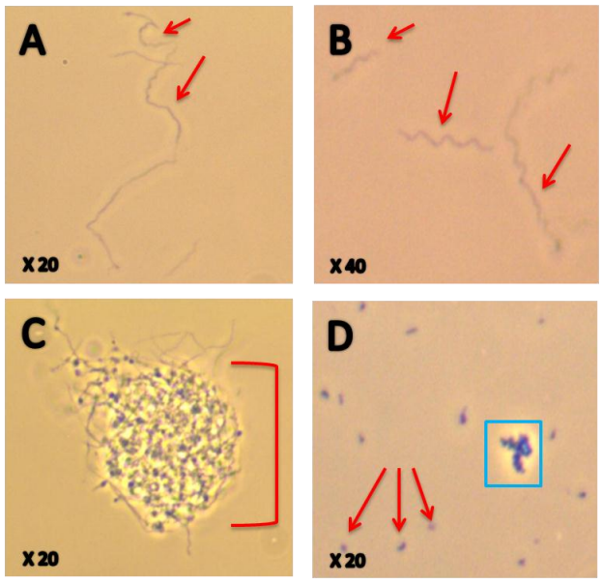
Morphological properties of Lyme Borrelia strains
Borrelia ( resistance/surviving )forms
antibiotics’ lack of efficacy

Slide 6
Diagnostics | Qualities and defects
Antibody-based | Give indirect evidence Low sensitivity ( early stages ) Can’t distinguish active and non-active Borrelia presence Difficult identification of Borrelia sub-types
Bacterial DNA-based | Direct evidence of Borrelia presence Low sensitivity Can’t distinguish live and dead Borrelia Might be able to tell different Borrelia sub-types
Lymphocyte transformation test | Provide indirect evidence Variable sensitivity that depends of immune system status and interfering treatments. False positive if time of incubation >24hours not reflecting real situation Can only detect Lymphocytes that have been in contact with Borrelia within 45±15 days, thus limited in application active Borrelia? Difficult identification of different Borrelia sub-types?

Slide 7
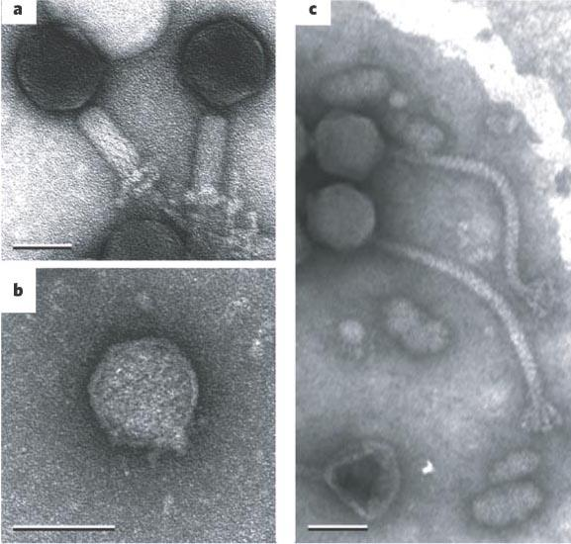
How phages look like?
Bar=50 nm=5×10⁻⁵ mm
Magnification of
150 000

Slide 8
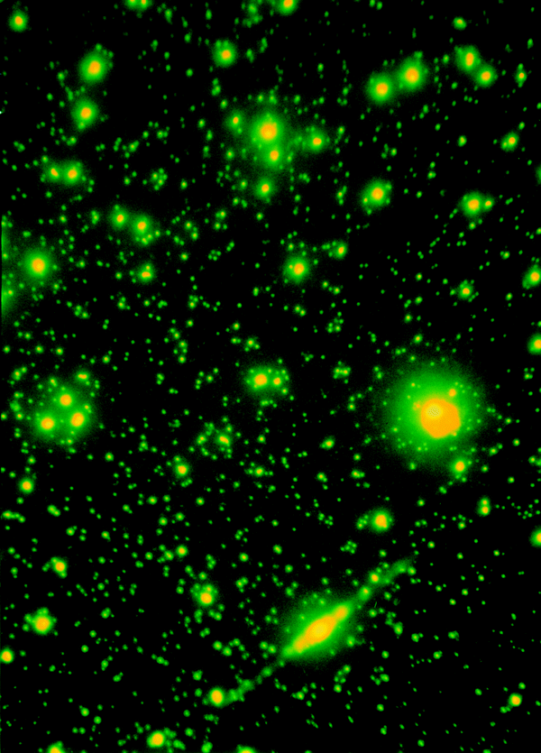
Phages are viruses that infect bacteria, and they are everywhere
50 million (5×10⁷) viruses per milliliter of seawater
Estimated number of phages:
The open ocean: 1.2 × 10²⁹
The soil: 2.6 × 10²⁹
The ocean sediments: 3.5 × 10³⁰
The terrestrial sub-surfaces: 0.25–2.5 × 10³⁰
There are 10/20 times more phages than bacteria
Fluorescence imaging of marine viruses
(Fuhrman J.A. 1999)
Notes:
There are probably more individual bacteriophages in the biosphere than there are of any other group of organisms, including all the prokaryotes. Until recently nobody knew how to get even an approximate estimate of how many phages there are, but a little over ten years ago, it occurred to someone that at least for the best studied group of phages, the tailed phages, their shape is so distinctive that their numbers in aquatic environments could be estimated simply by centrifuging them onto an electron microscope sample grid and counting them. Astonishingly, in coastal sea water there are typically as many as 10 7 (ten million) tailed phages per milliliter. In some fresh water sources there are up to 10 9 (a billion) per milliliter. Although there is still little information about how uniform is the distribution of phages around the globe, these numbers give at least a rough basis for calculating the global population. The remarkable result of such a calculation is that there may be as many as 10 30 tailed phage globally. For people who like their numbers written out, that’s 1,000,000,000,000,000,000,000,000,000,000. If you were to gather them all up and weigh them, they would outweigh the world population of elephants by a thousand-fold or more.
"If phages were the size of a beetle, they would cover the Earth and be many miles deep."

Slide 9
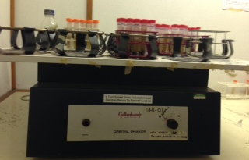
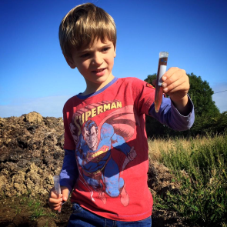
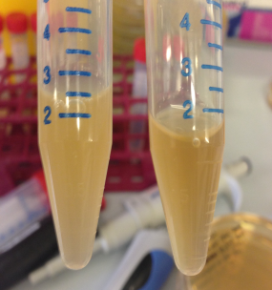
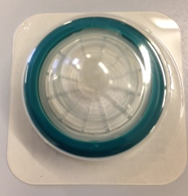
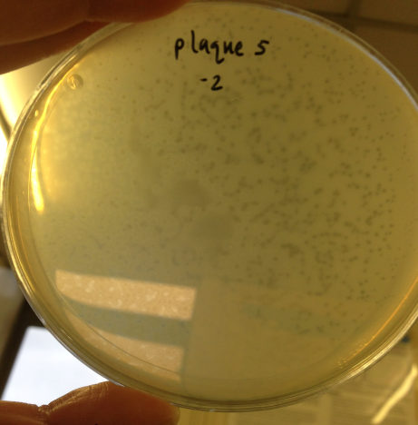
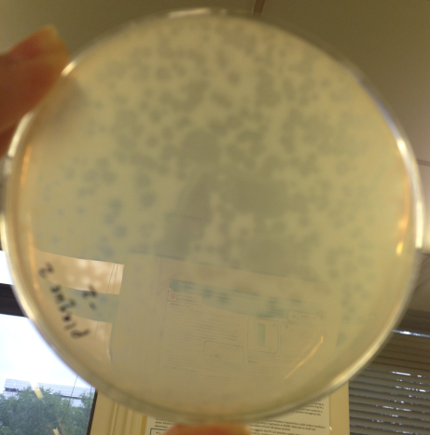
Phage isolation
+

Slide 10
Phage life cycle

Slide 11
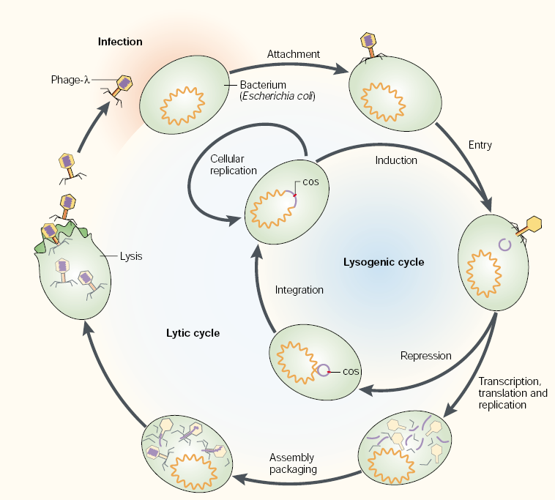
Phage life cycle
From Campbell (2003)

Slide 12
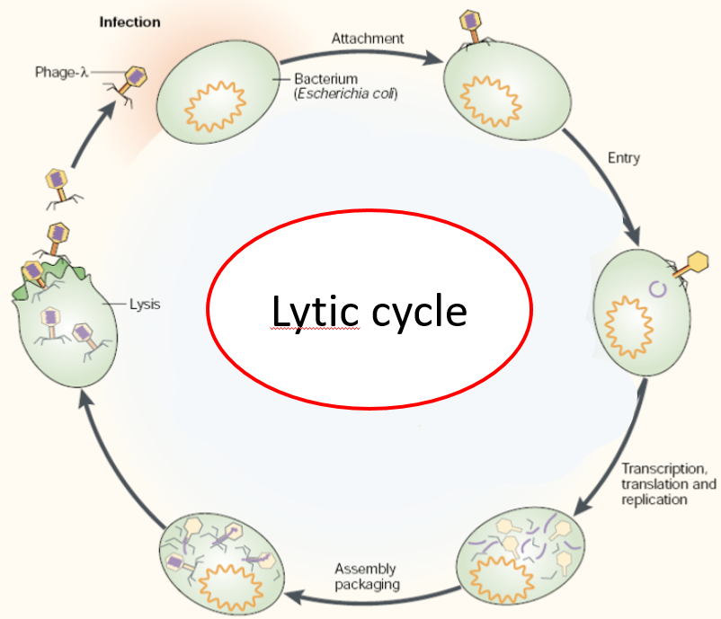
Virulent Phages (1)
The virulent phage, sometimes also called "lytic", infects its target and starts its reproduction immediately by mobilizing the resources of the host in its favor.
The viral genes are then expressed in a very precise and closely regulated order. The first proteins produced, the early proteins, are responsible for phage multiplication and, in many cases, interrupt the synthesis of cellular proteins. Some virulent phages are even capable of degrading the host genome and monopolizing cellular metabolism for their own reproduction.
Notes:
Une fois les nouvelles particules formées, un nombre qui varie largement en fonction du type de phage, la bactérie est lysée par des protéines virales qui dégradent la paroi cellulaire.
Les virus ainsi libérés peuvent entamer un nouveau cycle d’infection.

Slide 13
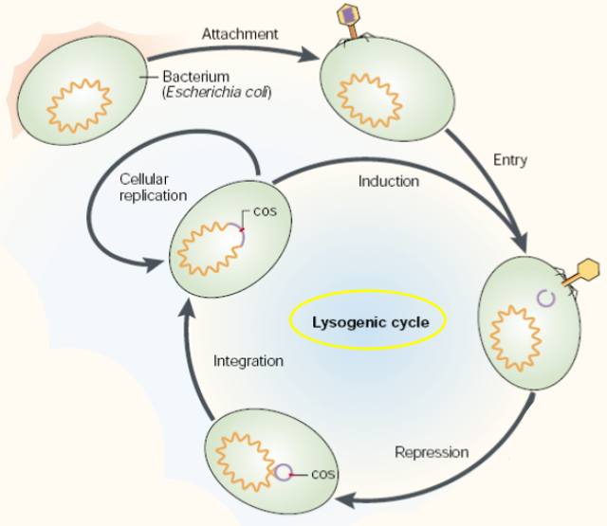
Phage life cycle
Filamentous Phages
When nucleic acid (generally single-stranded) is injected into the target cell, the capsid proteins are inserted into the membrane. Once inside the host, the genome is abundantly replicated and the genes necessary for the synthesis of structural proteins are expressed.
Proteins will in turn enter the cytoplasmic membrane and, together with the structural proteins inserted in the membrane during infection, will serve to form the new capsids. The phages are then secreted through the cell wall via a channel formed of three viral protein species according to a process consuming ATP. Unlike other types of phage, filamentous phages do not kill their host, but are released as they replicate. This interesting characteristic makes it the tools of choice in molecular biology
From Campbell (2003)

Slide 14
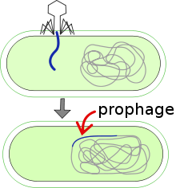
Prophages
In most cases, viral DNA integrates physically into the host genome and is copied with the entire genome as the cells divide.
This state may persist for several generations and the host cell is then said to be lysogenic. The quiescent state is maintained by a repressor of the lytic functions. Its role is to ensure the stability of the prophage state and at the same time to enable it to enter the active phase rapidly when circumstances demand it. This is the case when the bacterium is exposed to a deficiency or stress damaging its integrity for example. The prophage then comes out of its quiescent state and activates its replicative cycle like the virulent phages.
Notes:
il n'est pas un
phage actif, mais préserve
toutefois le potentiel de produire des particules

Slide 15
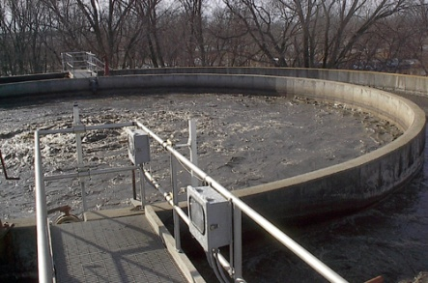
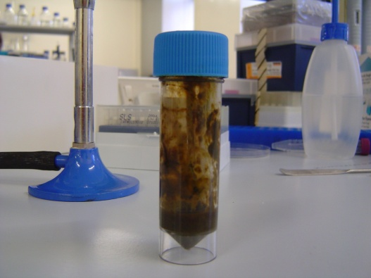
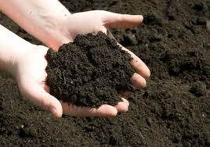
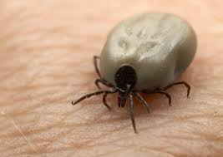
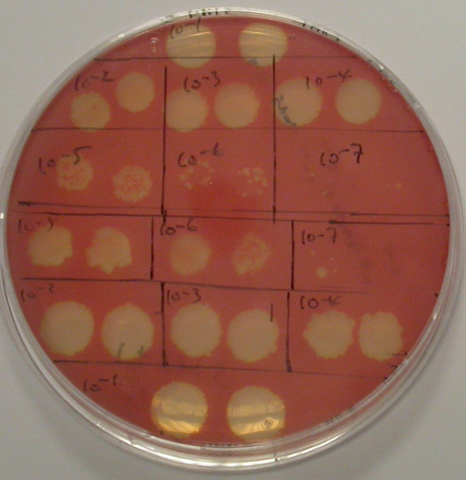
How to detect/identify phages?
Sampling: where there are bacteria, there are phages
Petri dish
An example of ‘spot test’: the red background was a bacterial lawn, the clear spots were ‘phage drops’ with serial dilutions. Single ‘plaque’ can be seen

Slide 16
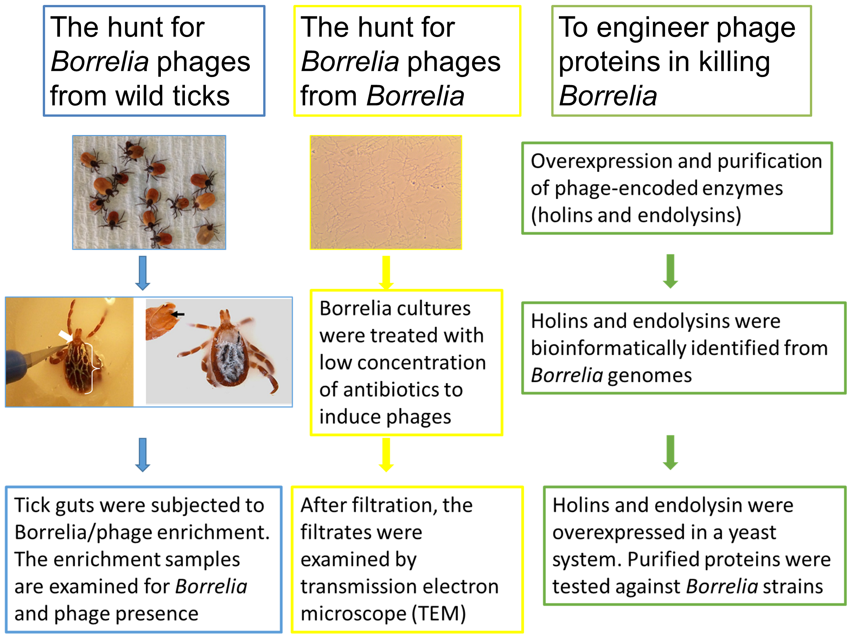
Three strategies for Borrelia phages

Slide 17
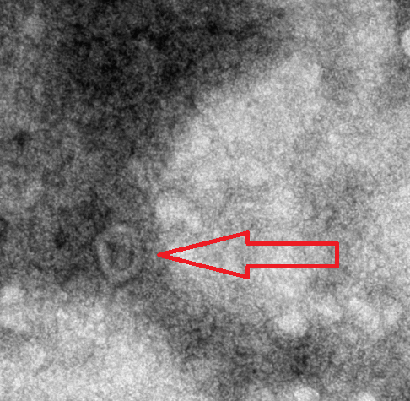
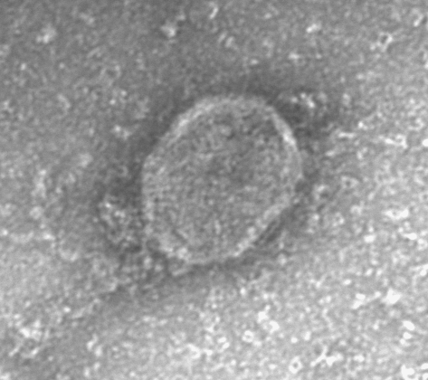
Our Research & Development
We were able to induce Temperate phages from Lyme Borrelia strains (table below).
We increased the phage concentration and phage purification.
Phages can be seen under transmission electron microscope (TEM)
Notes:
Conditions that will induce phage out of bacteria

Slide 18
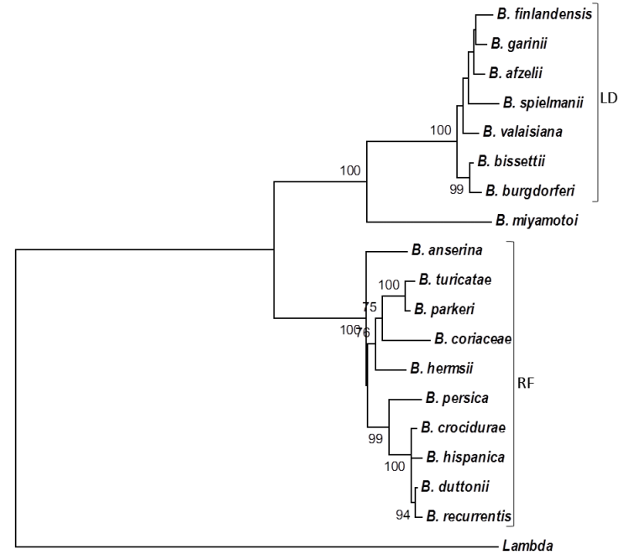
Phages residing within Borrelia strains are tightly correlated to the identity of their bacterial hosts.
Notes:
interestingly the B. myomatoi species was not grouped with either the LD or RF causing strains . Recent reports have stated that B. miyamotoi causes a disease showing symptoms of both LD and RF. This gives a possibly indication of the prophage contribution to the Borrelia spp. biology. Is this from the phage-based tree?

Slide 19
Phage-based test design and calibration
RATIONALE: Phages are specific , circulate and are much more numerous than their targets
Phelix Charity (chronic infections and bacteriophages research group) Department of Infection, Immunity, and Inflammation, Uniiversity of Leicester
OBJECTIVES
• Determine the sensitivity and specificity of a phage-based PCR diagnostic method in detecting the presence of Borrelia in blood
• Validate a phage-based PCR diagnostic method against the current antibody-based (ELISA + WB) and bacteria PCR-based Methods.
Phage-based PCR:
Several sets of PCRs specifically targeting the conserved regions of Borrelia phages residing inside Borrelia strains were applied to the DNA extracted from the whole blood and sera samples. These PCR primers include one set that targets all of the Borrelia burgdorferi s.l., and several other different sets of primers/probes that are specific for Borrelia afzelii, Borrelia garinii, and Borrelia miyamotoi. The PCR product is visualised based on a capillary gel system, and a Taqman qPCR system.

Slide 20
Method development: specificity on lab strains
PCR primers were designed targeting conserved regions within Borrelia phages.
PCR was validated against all known bacteria using in silico PCR (http://insilico.ehu.eus/PCR/).
‘Wet PCR’ were performed against LD&RF Borrelia strains and the following bacteria in the lab, such as Clostridium difficile, Burkholderia thailandensis, E. coli, Salmonella, Legionellae, and Haemophilia strains None of these bacteria generated any PCR products.
Fig. 1 Phage PCR was carried out against different Lyme Borrelia strains.
A single PCR product was generated from each DNA sample with the expected size and sequence. PCR was run in duplicate for each DNA template. Every two lanes represent one PCR as follows: 1, 2: negative control; 3, 4: B. burgdorferi B31; 5,6: B. burgdorferi VS185 P9; 7,8: B. valaisiana NE218; 9, 10: B. afzelii ACA1; 11, 12: B. burgdorferi UK filtered; 13, 14: B. garinii 190 P9; 15, 16: B. burgdorferi China23. The size of DNA ladders on both edges were indicated in bps.

Slide 21
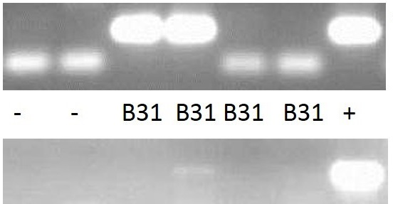
Method development: sensitivity on lab s
The phage PCR and bacterial PCR were carried out against four Borrelia burgdorferi B31 culture, which has been diluted down to 10 Borrelia/ml.
Phage PCR
Bacterial PCR
Fig. 2 Two strong PCR positives were observed from phage PCR (top panel), and one weak positive was observed from bacterial PCR. The DNA templates used in the PCR were extracted from diluted Borrelia cultures with a concentration of 10 Borrelia/ml.

Slide 22
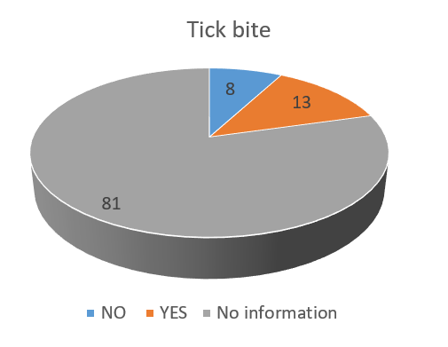
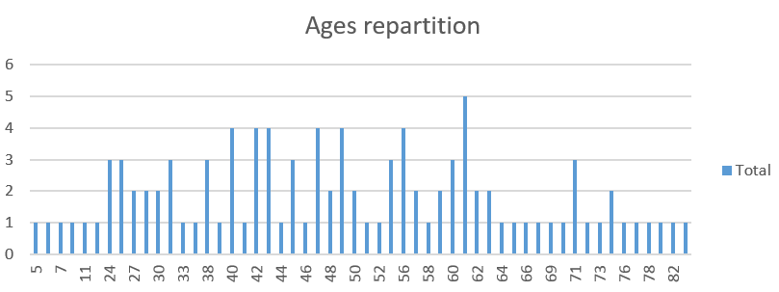
First results: Scope of study (102 people presenting Lyme disease symptoms )

Slide 23
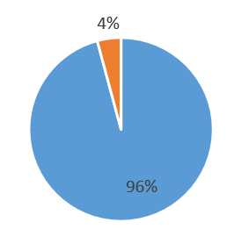
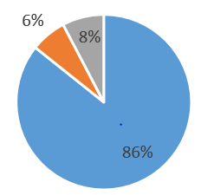
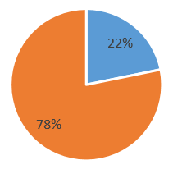
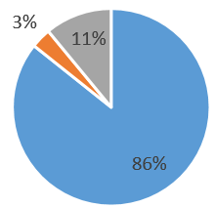
First results: Phage test
versus serological IgG tests
ELISA
Western Blots
Doubt means either:
- Negative with Blots
- Negative Border Line
Phage TEST
Combination
WB+ELISA results

Slide 24
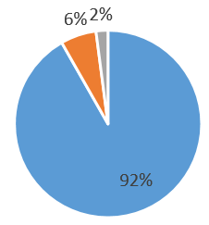
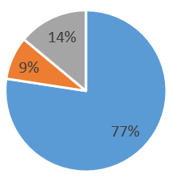
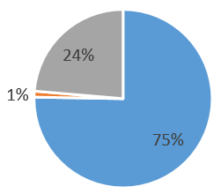
First results: Phage test
versus serological IgM tests
ELISA
Western Blots
Doubt means either:
- Negative with Blots
- Negative Border Line
Phage TEST
Combination
WB+ELISA results

Slide 25
First results: activity detection
Focus on 3 patients with positive results in IgG :
 | ELISA (IgG) | Western Blot (IgG) | Phage test
Patient 1 | + | + | +
Patient 2 | + | + | +
Patient 3 | + | + | -
Phage test detects Borrelia active presence, while Elisa and Western Blots (IgG) only detect a former contact with the bacteria.

Slide 26
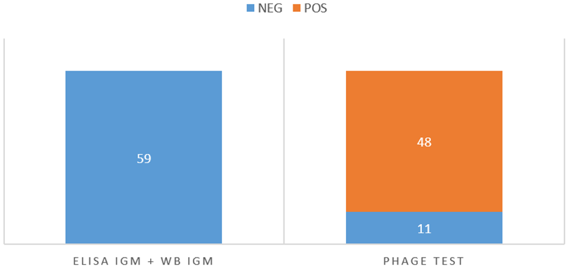
First results: false negative detection
Focus on the patients with negative results in both ELISA and WB IgG and IgM:
Phage test detects the presence of active phages in a large number of patients having both negative ELISA and WB (IgG and IgM).

Slide 27
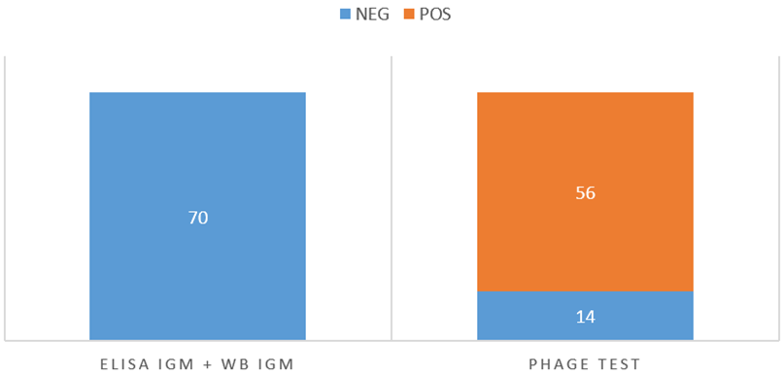
First results: IgM false negative detection
Focus on the patients with negative results in both ELISA and WB IgM only:
Phage test detects the presence of active phages in a large number of patients having both negative ELISA IgM and WB IgM.

Slide 28
Phage-based PCR test : validation
Its high sensitivity makes it able to detect the disease in the first weeks of infection as well as in the late stages
Phage-based PCR is an in vivo amplification system
It’s high specificity permits to distinguish between the two tick-borne diseases and indicates the bacterial species involved

Slide 29
Performance of the qPCR in clinical samples
Table 1. Comparison of phage PCR and ELISA/WB Assays for detecting Borrelia in serum collected from 96 patients who were clinically diagnosed as ‘Lyme disease’ by Dr Louis Teulieres.
Phage qPCR results | Serological results |  | Total
 | Positive | Negative
Positive | 15 | 73 | 88
Negative | 0 | 8 | 8
Total | 15 | 81 | 96
Phage qPCR: 88/96 × 100%= 92%
Serological assay: 15/96 × 100%= 16%

Slide 30
Performance of the qPCR in clinical samples
Table 2. Comparison of phage PCR and Bacterial PCR for detecting Borrelia in serum collected from 96 early stage patients who were clinically diagnosed as ‘Lyme disease’ by Dr Louis Teulieres.
Phage qPCR results | Bacterial qPCR |  | Total
 | Positive | Negative
Positive | 33 | 55 | 88
Negative | 0 | 8 | 8
Total | 33 | 63 | 96
Phage qPCR: 92%
Bacterial qPCR: 34%

Slide 31
Performance of the qPCR against clinical samples
Table 3. Comparison of phage PCR and Bacterial PCR for detecting Borrelia in whole blood collected from 81 late patients who were clinically diagnosed as ‘Lyme disease’ by Dr Louis Teulieres.
Phage qPCR results | Bacterial qPCR |  | Total
 | Positive | Negative
Positive | 31 | 40 | 71
Negative | 0 | 10 | 10
Total | 31 | 50 | 81
Phage qPCR: 88%
Bacterial qPCR: 38%

Slide 32
Performance of the qPCR in clinical samples
Table 4. Comparison of phage PCR and Bacterial PCR for detecting Borrelia in whole blood collected from 25 healthy volunteers who were organised by Dr Louis Teulieres.
Phage qPCR results | Bacterial qPCR |  | Total
 | Positive | Negative
Positive | 3 | 9 | 12
Negative | 0 | 13 | 13
Total | 3 | 22 | 25
Phage qPCR: 48%
Bacterial qPCR: 12%

Slide 33
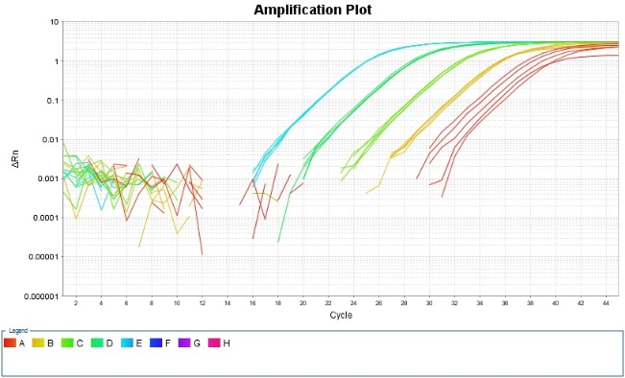
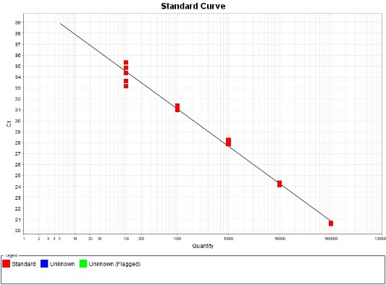
Detection of bacteriophage nucleic acids from whole blood and serum samples by a Taqman-based quantitative PCR with an internal control offers highly sensitive diagnosis of Lyme disease
Taqman primers and probes targeting phage genes + Taqman probe and primer set targeting an internal control are optimised/verified
A standard curve from serial dilution of plasmid carrying phage gene is generated
Determined the Limit of detection (LoD)
Copy number/PCR | Number of replicates | Number of PCR positive replicates (% of positive)
100 | 10 | 10 (100%)
80 | 10 | 10 (100%)
60 | 10 | 10 (100%)
40 | 10 | 10 (100%)
20 | 10 | 9 (90%)
10 | 10 | 7 (70 %)
5 | 10 | 2 (20%)
1 | 10 | 0

Slide 34
Summary of the phage-based test
Highly sensitive and specific.
The efficiency of the phage-based PCR was estimated by spiking human blood with known amount of Borrelia cultures. The lowest concentration that still generated a positive signal was 5 Borrelia/ml of blood.
Direct evidence of active Borrelia presence
Ability to distinguish different Borrelia sub-types)
Early stages anad late stages diagnostics .Treatments and medicines monitoring
IN VIVO AMPLIFICATION SYSTEM
Practical aspects
The test works on whole blood (EDTA coated vials) ; A test performed on whole blood is more sensitive than the one performed on Serum.
We are working to make it available to The test requires 10ml of whole blood (5ml for the test, and 5ml for back-up)
We have selected R.E.D LABS as a partner for it’s capability to perform a specific manual DNA extraction followed by qPCR techniques.
R.E.D LABS has a large technical platform in Europe ( BRUSSELS) and also an easy to reach facility in the USA (RENO, NV)
7500
x25

Slide 35
Comparison of GeneProof (commercial PCR) and phage tests to determine Borrelia presence: Results from 66 patients within the 96-patient cohort
66 patients were random selected from the 96-patient cohort. Nine patients showed both GeneProof and phage positive, while 54 patients showed phage positive and GeneProof negative. 3 patients showed negative for both tests.
9 54 3

Slide 36
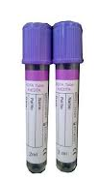
Phelix Phage Test Procedure
Manual DNA Phenol/Chloroform extraction
3 different qPCR s
Confirmatory sequencing for positive-like samples

Slide 37
PCR Phages sensitivity and specificity
B. burgd
B. miya
B. hermsii

Slide 38
Future objectives : Develop phage endolysin-based products targeting Borrelia, Bartonella, Mycoplasma, and Rickettsia infections.
We have identified Borrelia phage endolysins and are testing their anti-Borrelia activity in lab using our ‘in-house’ spot test method. A clear kill zone is revealed with positive results. The same methodology will be applied to analyse Bartonella, Mycoplasma, Rickettsia genomes. Preliminary results showed that several copies of potential endolysins located in Bartonella genomes. Analysis will be conducted to confirm their identity before carrying out protein expression.

Slide 39
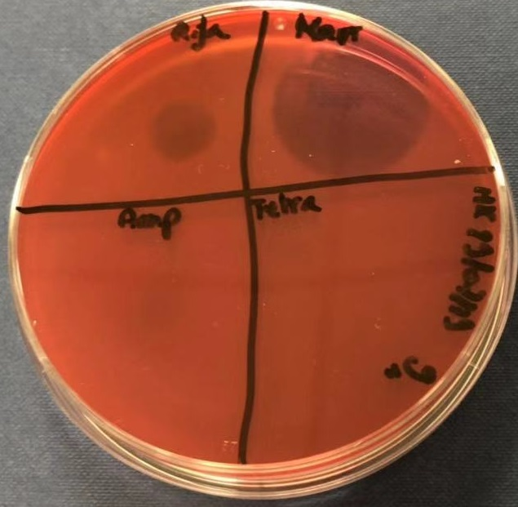
Further developments
The antibiotic used for spotting on the Borrelia lawn were 20 µl of tetracycline (100 mg/ml),
Ampicillin (100 mg/ml), Kanamycin (50 mg/ml),
and Rifampicin (25 mg/ml). Interestingly, it seemed that all the four antibiotics used showed
no clear against B Spielmanii. Kanamycin is much better in killing Borrelia burgdorferi than
tetracyclin and Ampicillin. Rifampicin has no visible effect against B. burgdorferi Kanamycin was twice as effective as Rifampicin in killing Borrelia bisettii, while both Ampicillin and tetracycline has
no visible effect on B. bisettii. All four antibiotics can kill B. afzellii

Slide 40
REFERENCES
Bacteriophage behavioral ecology: How phages alter their bacterial activities ..
review article.
Phages in nature · Martha R.J. Clokie et al. Bacteriophage. Volume 1, 2011 - Issue 1.
https://www.tandfonline.com/doi/abs/10.4161/bact.29866Published online: 1 Jan 2013.
Prophage Carriage and Diversity within Clinically Relevant Strains of Clostridium difficile
Jinyu Shan, Krusha V. Patel, Peter T. Hickenbotham, Janet Y. Nale, Katherine R. Hargreaves, Martha R. J. Clokie
Environmental Microbiology
Isolation and characterization of temperate bacteriophages ofClostridium difficile.
Goh S, Riley TV, Chang BJ2005. Is Appl. Environ. Microbiol. 71: 1079–1083.
Phage based diagnosis of bacterial infections
Hari Mohan Saxena Vimlesh GuptaMini-ReviewPublish Date : 2016-09-03
Journal of Clinical Trials, Pathology and Case Studies
Development of a Bacteriophage Phage Replication Assay for Diagnosis of Pulmonary Tuberculosis
Ruth McNerney, Bupe S. Kambashi, Juliana Kinkese, Ruth Tembwe, Peter Godfrey-Faussett
ASM DOI: 10.1128/JCM.42.5.2115-2120.2004
Sci Rep. 2018; 8: 5091.
Published online 2018 Mar 23. doi: 10.1038/s41598-018-23418-y
PMCID: PMC5865146
PMID: 29572482
Bacteriophages are more virulent to bacteria with human cells than they are in bacterial culture
; insights from HT-29 cells
Jinyu Shan, ¹ Ananthi Ramachandran,^{#1} Anisha M. Thanki,^{#1} Fatima B. I. Vukusic,¹
Jakub Barylski,² andMartha R. J. Clokie
Holins: the protein clocks of bacteriophage infectionsang IN,
Wang Smith DL, Young R 2000. . Annu. Rev. Microbiol. 54: 799–825. ¹
Notes:
Both phage therapy and Lyme diseases are controversial, what is gonna happen if you put two controversies together?

Slide 41
Partners
Dr TEULIERES : louis.teulieres@phelix.org.uk

